Slide 1
Lecture - 18
Chapter 10
IMAGE SEGMENTATION

Slide 2
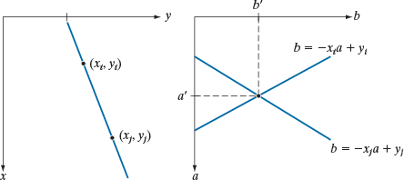

Hough Transform
Global Edge Linking Method
(x_{i} , y_{i} ) & y = ax + b ⇒ y_{i} = ax_{i} + b b = −x_{i}a + y_{i}
All (x_{i} , y_{i} )'s on a line intersect each other at (a,b)

Slide 3
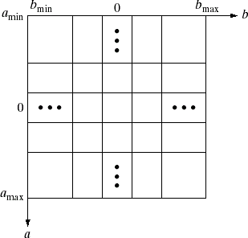
Hough Transform
Global Edge Linking Method
Hough Transform in Cartesian:
– Scan and fill the parameter space
(a,b)
(x₁, y₁ )
(x₂, y₂ )
(x₃, y₃ )
(x₄, y₄ )

Slide 4
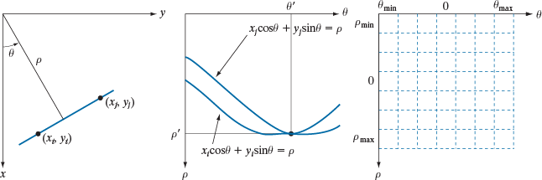

Hough Transform
Global Edge Linking Method
Hough Transform in Polar:
(x_{i} , y_{i} ) & ρ = x cosθ + y sinθ
⇒ ρ = x_{i} cosθ + y_{i} sinθ
All (x_{i} , y_{i} )'s on a sin intersect each other at (ρ,θ)

Slide 5
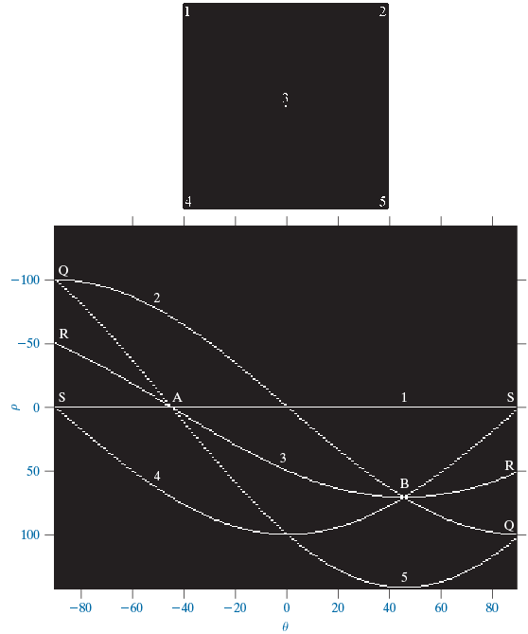
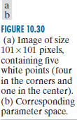
Hough Transform (example)
Global Edge Linking Method

Slide 6
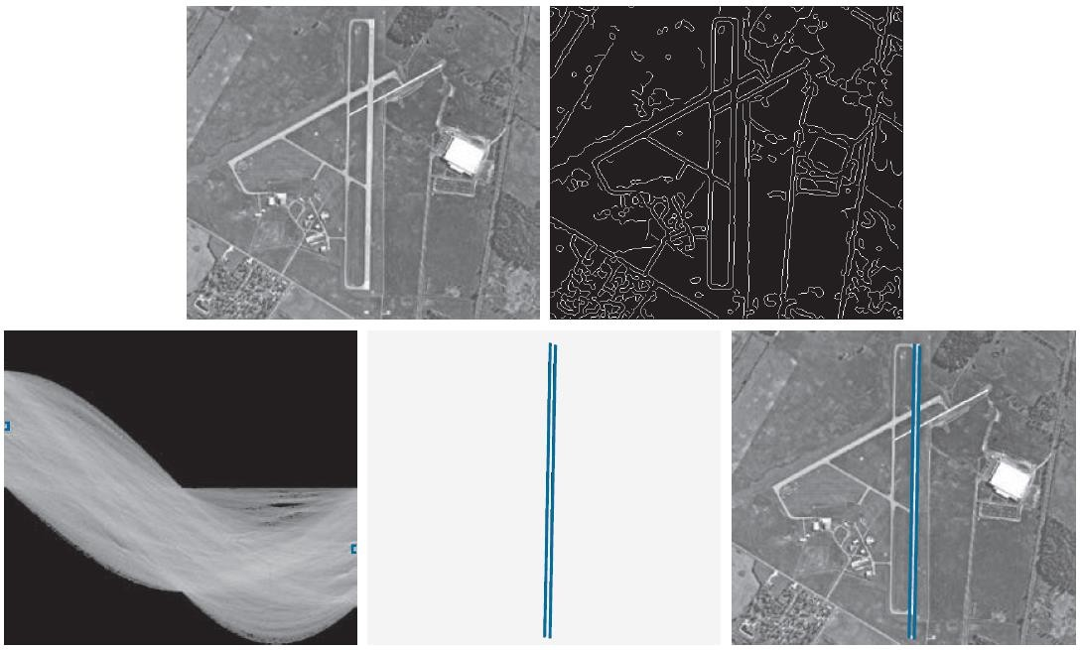

Hough Transform (example)
Global Edge Linking Method

Slide 7
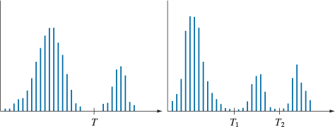
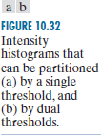


Basic Intensity Thresholding

Slide 8
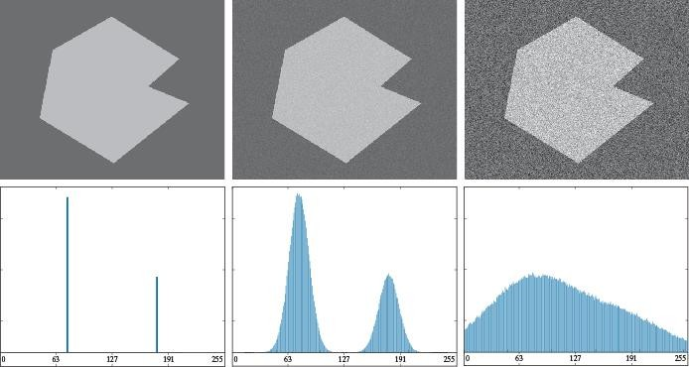

Role of Noise in Image Thresholding

Slide 9
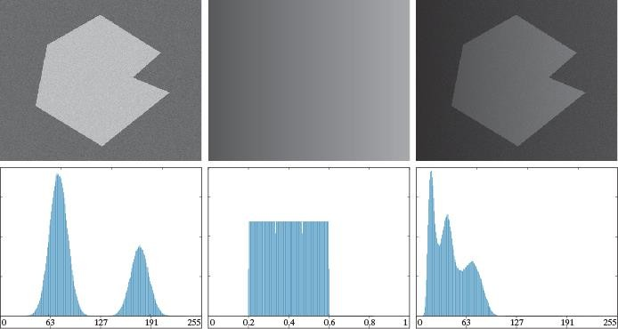

Role of Illumination and Reflectance

Slide 10
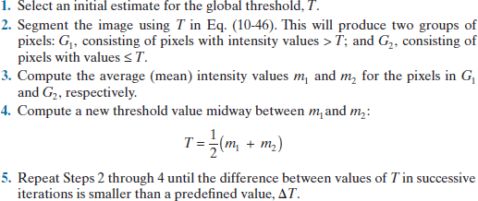
Basic Global Thresholding

Slide 11
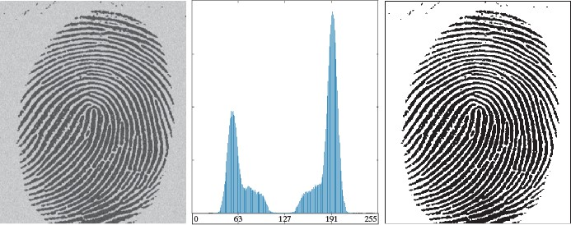
Basic Global Thresholding

Slide 12
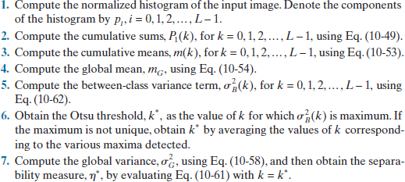






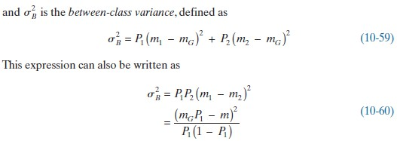


Optimum Global Thresholding using OTSU’s Method

Slide 13
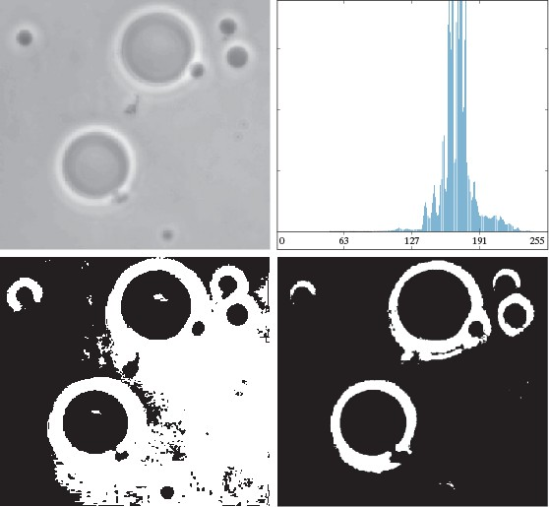
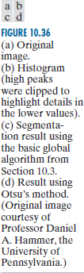
Optimum Global Thresholding using OTSU’s Method

Slide 14
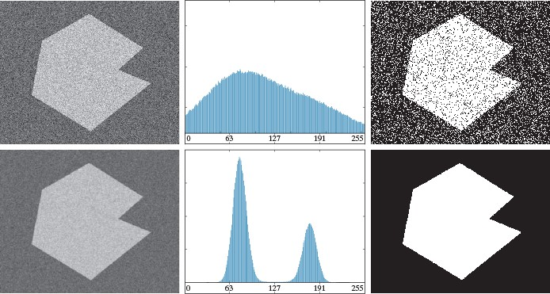

Using Image Smoothing to Improve Global Thresholding

Slide 15
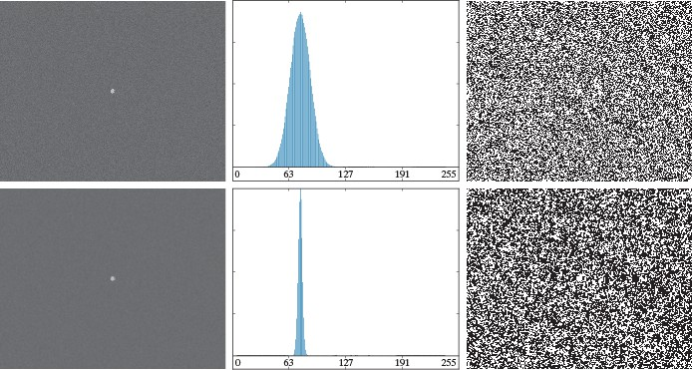

Using Edges to Improve Global Thresholding

Slide 16
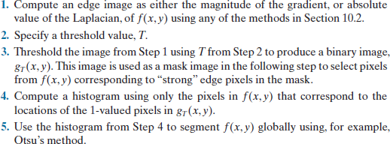
Using Edges to Improve Global Thresholding

Slide 17
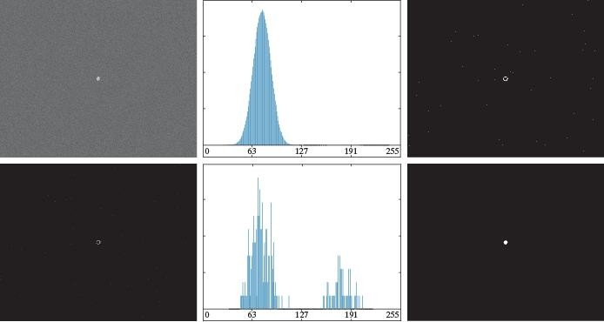
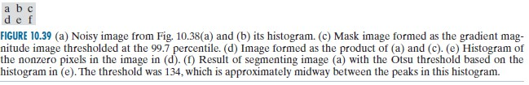
Using Edges to Improve Global Thresholding

Slide 18
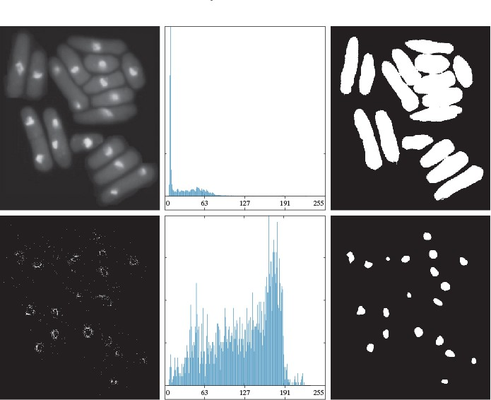

Using Edges to Improve Global Thresholding

Slide 19

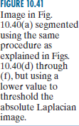
Using Edges to Improve Global Thresholding

